Slide 1
Effective and Efficient
Knowledge-Intensive NLP
Meng Jiang
Department of Computer Science and Engineering
University of Notre Dame

Slide 2
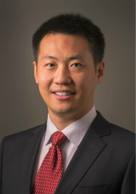
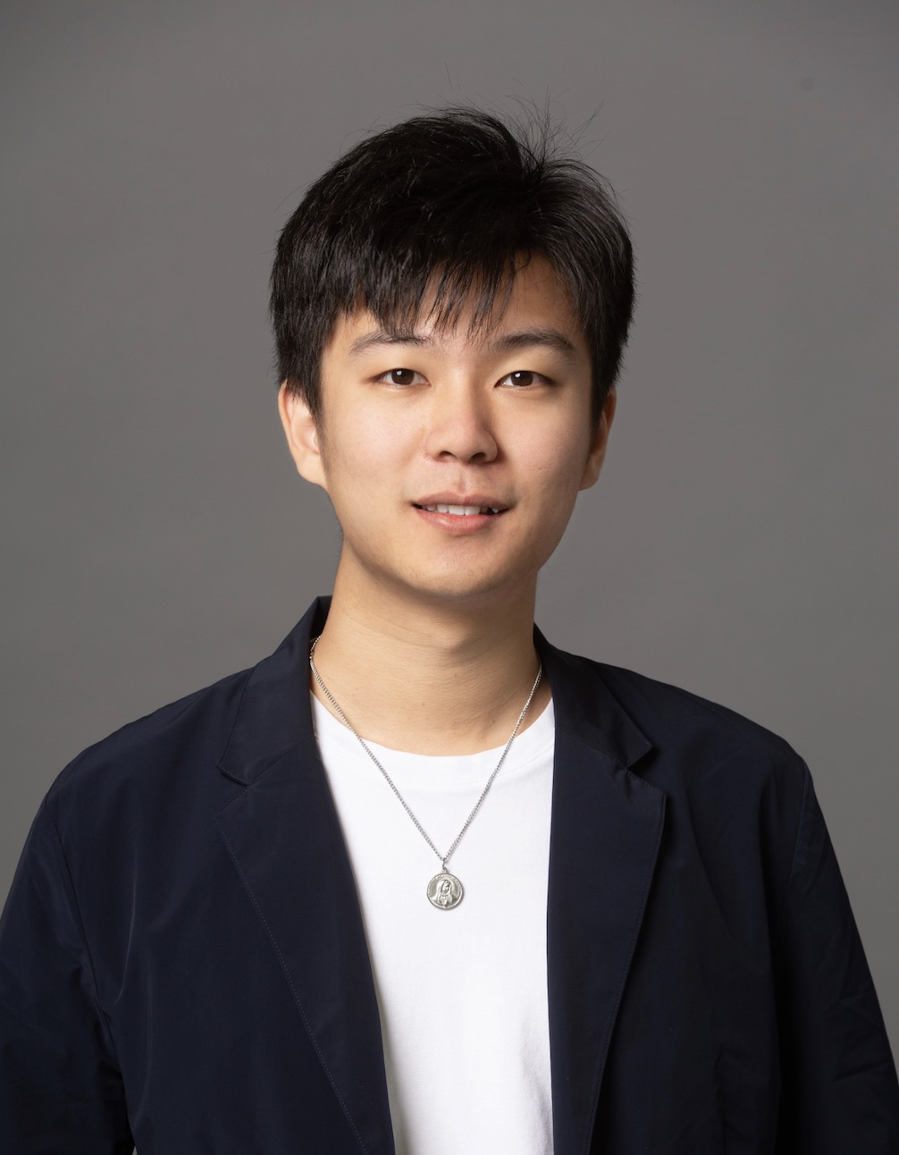
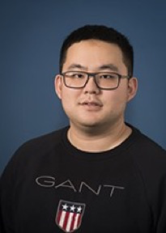
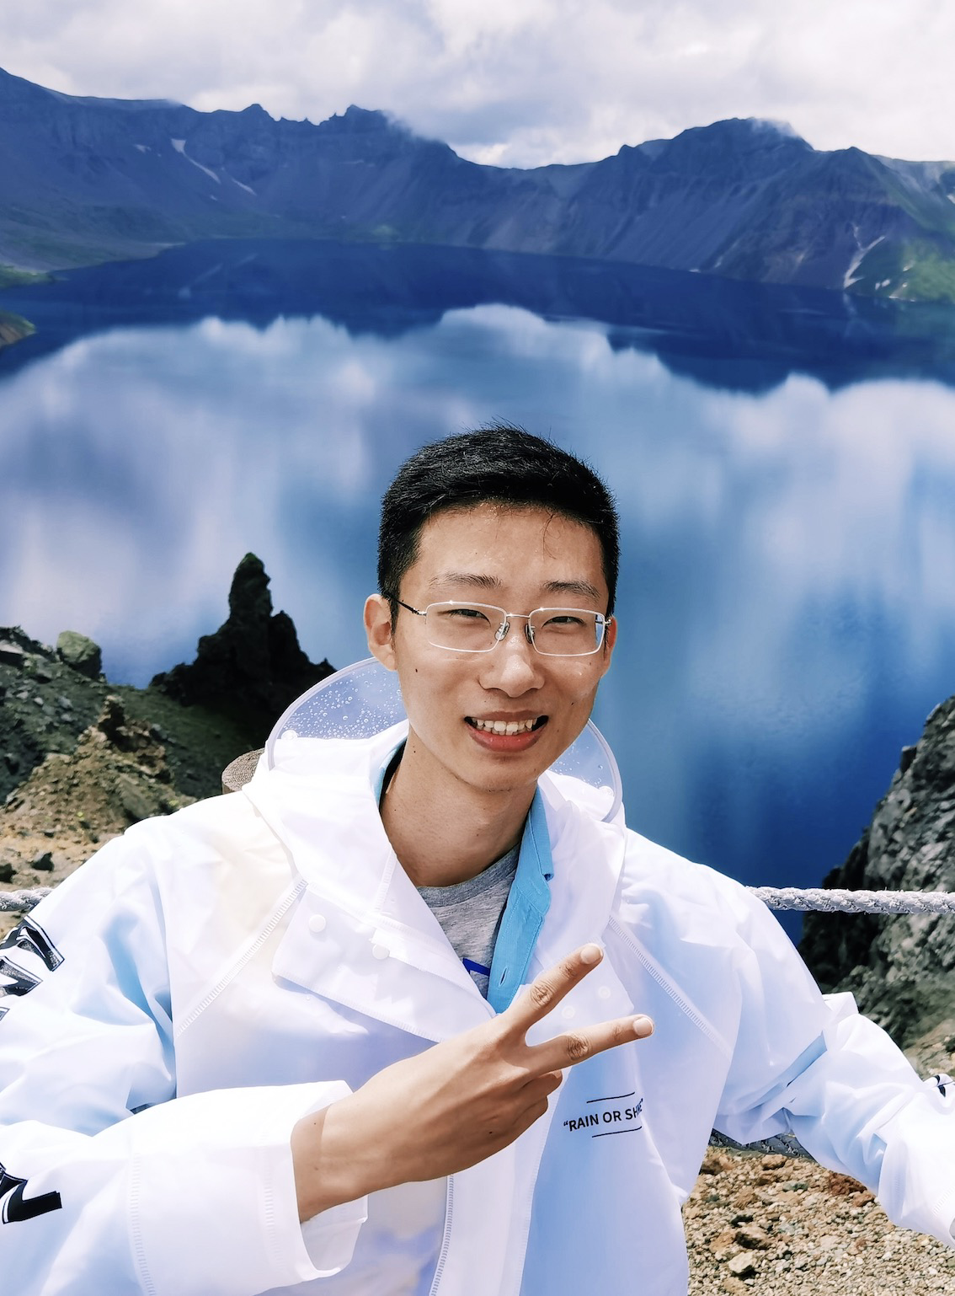
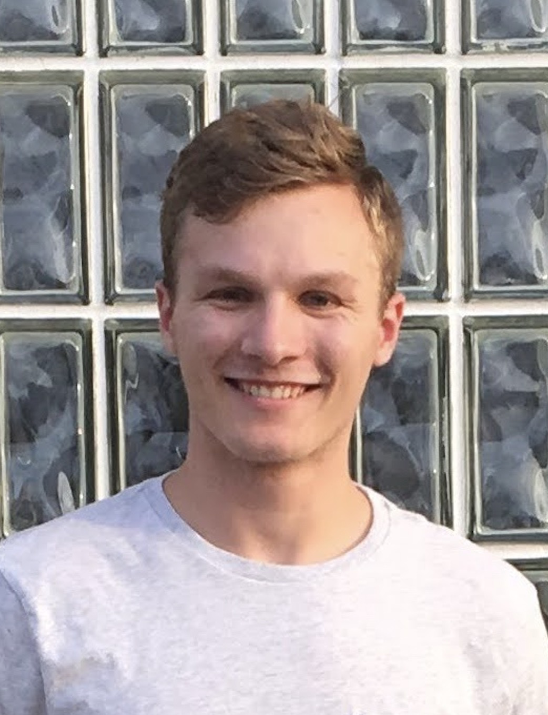
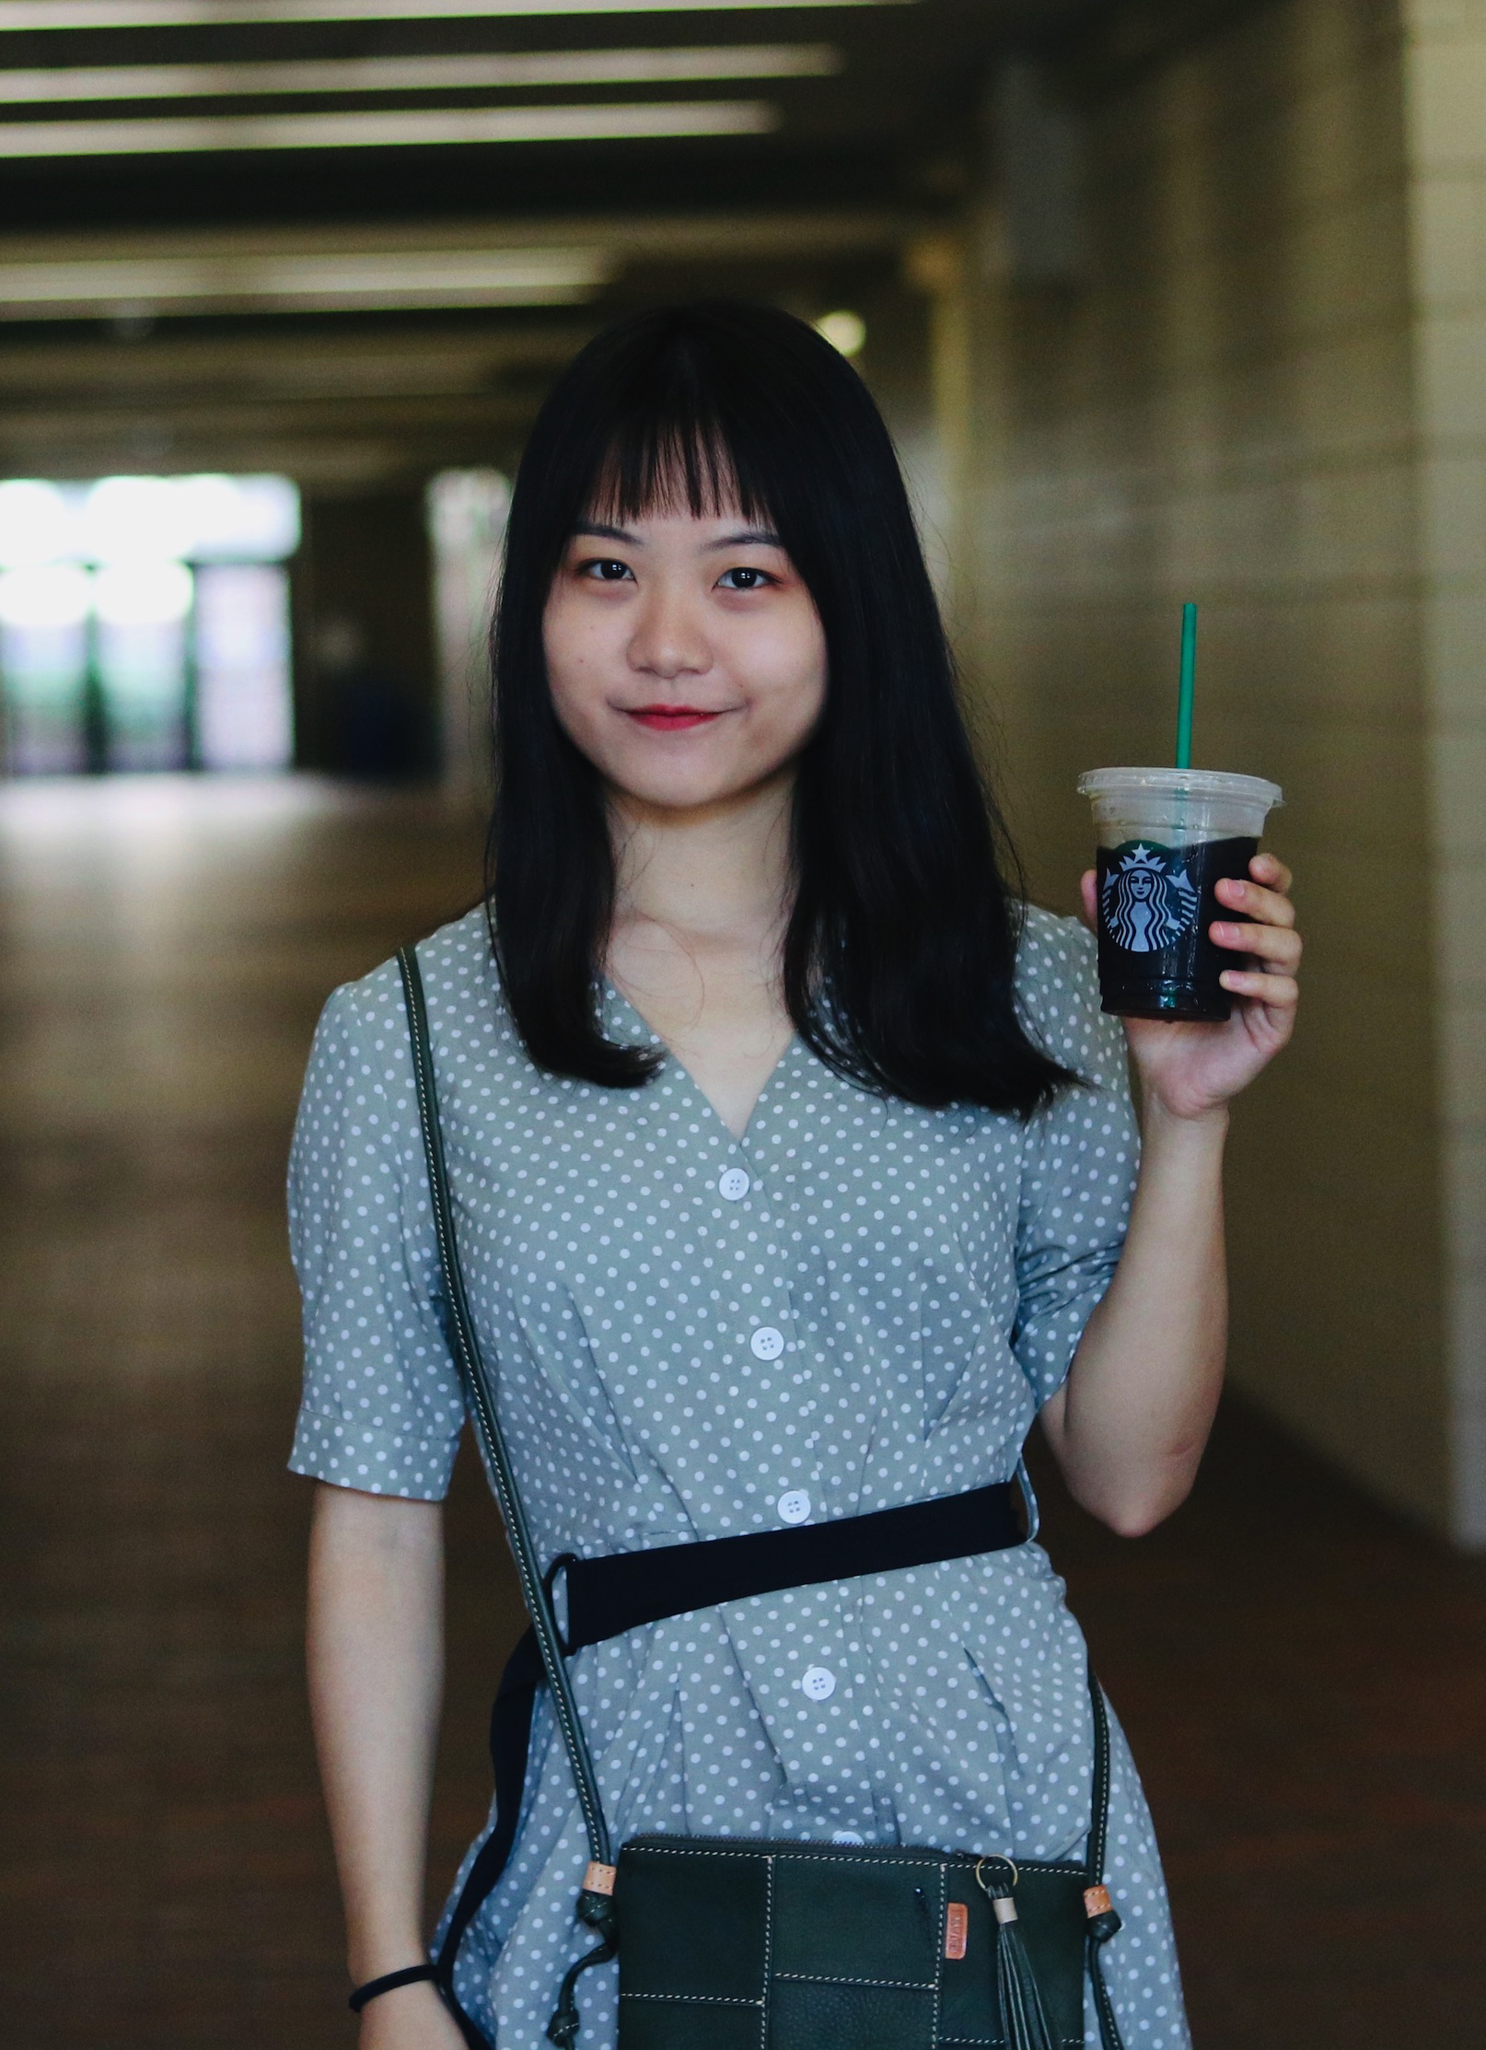
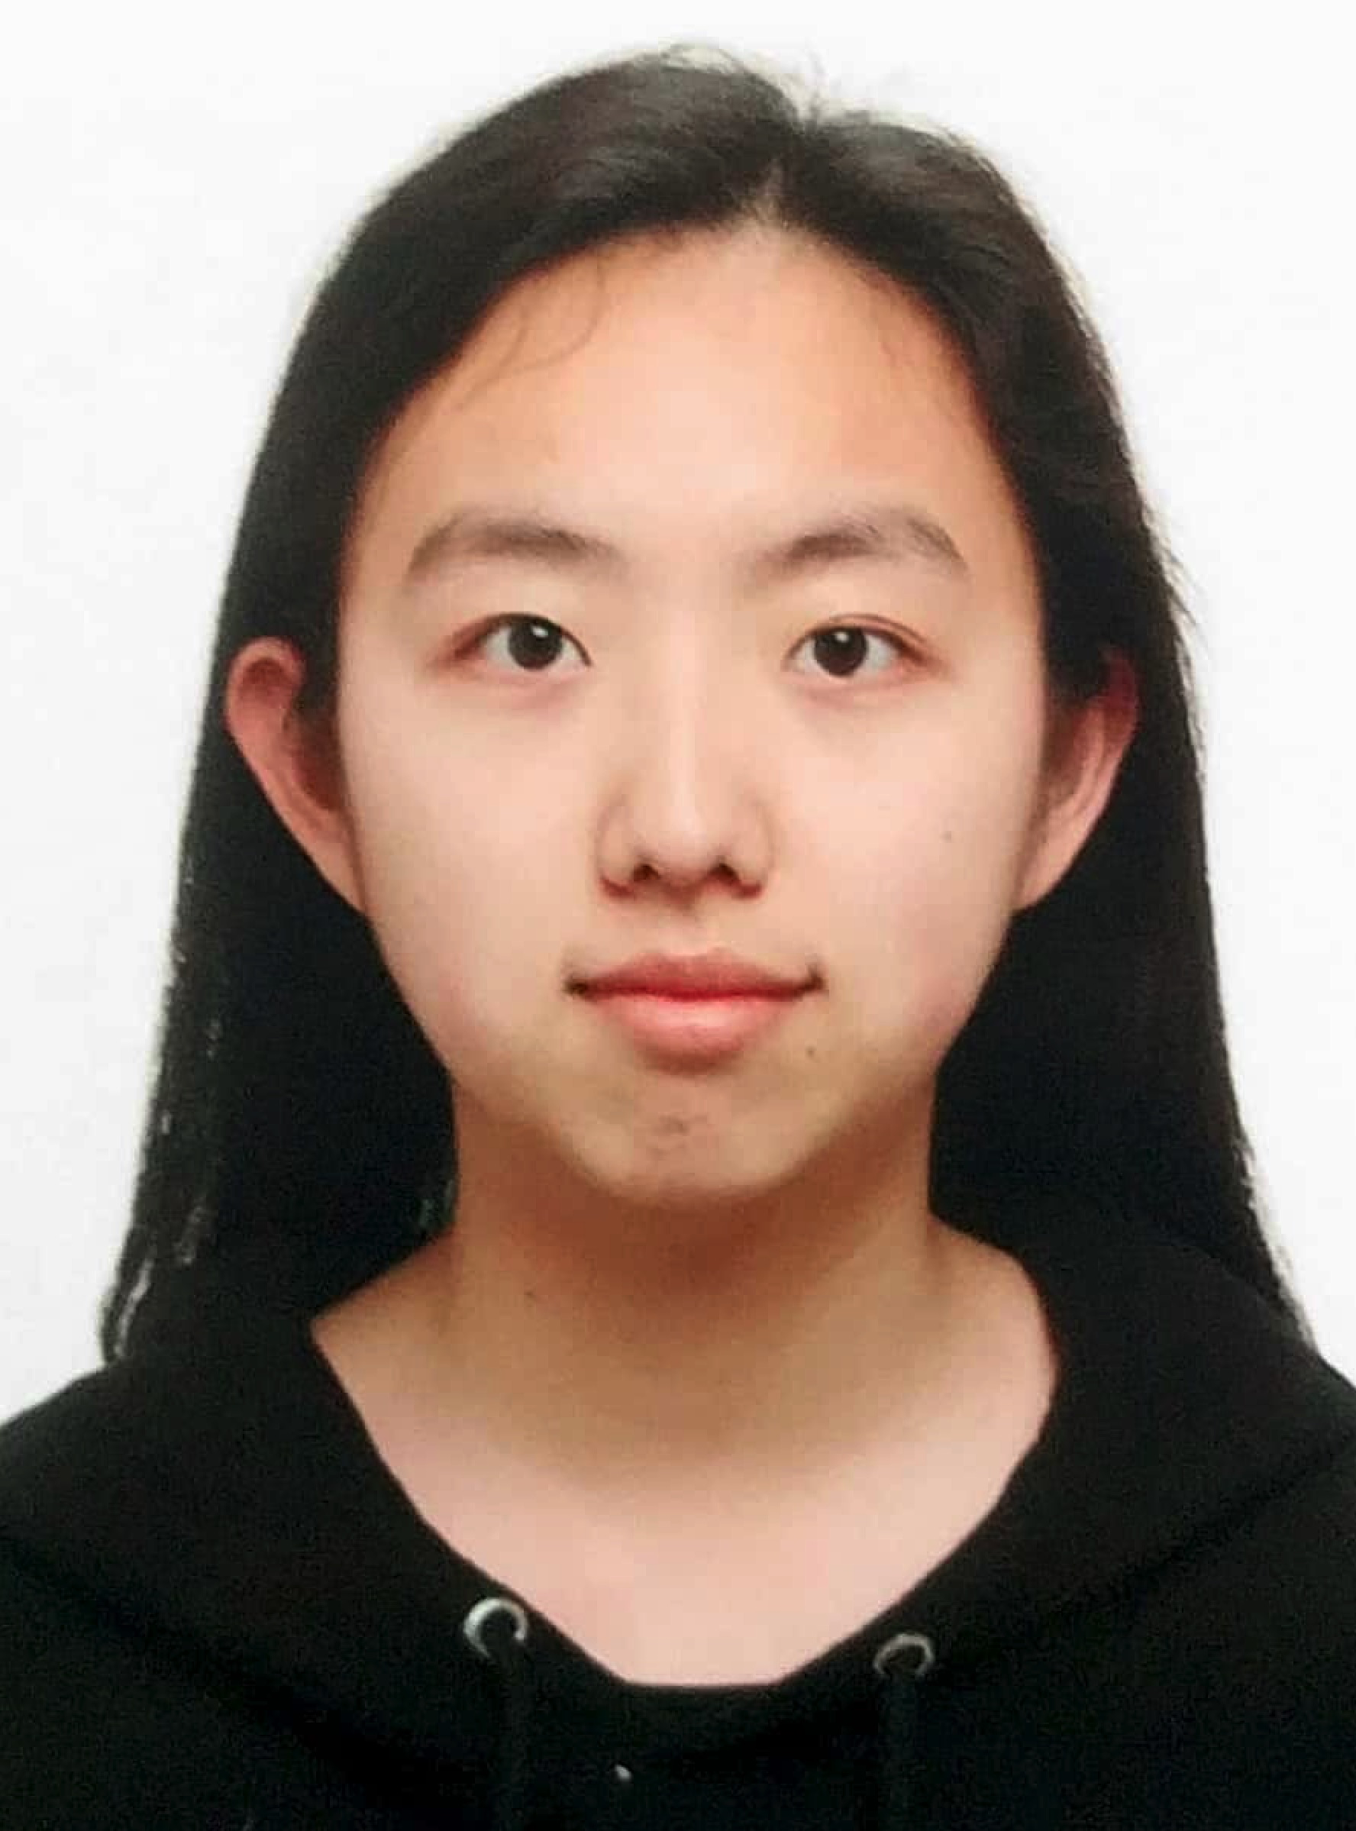

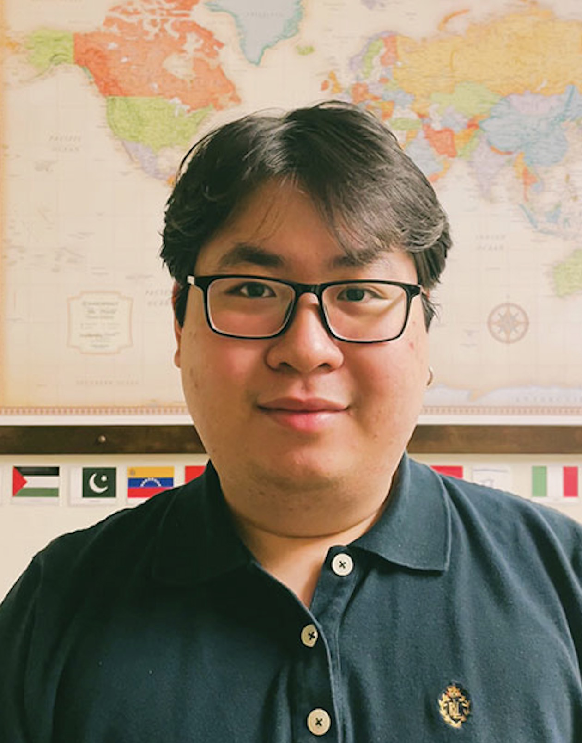
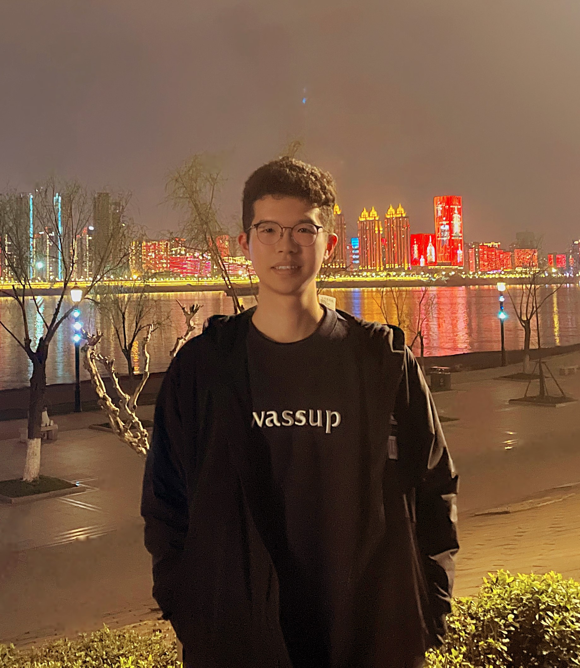
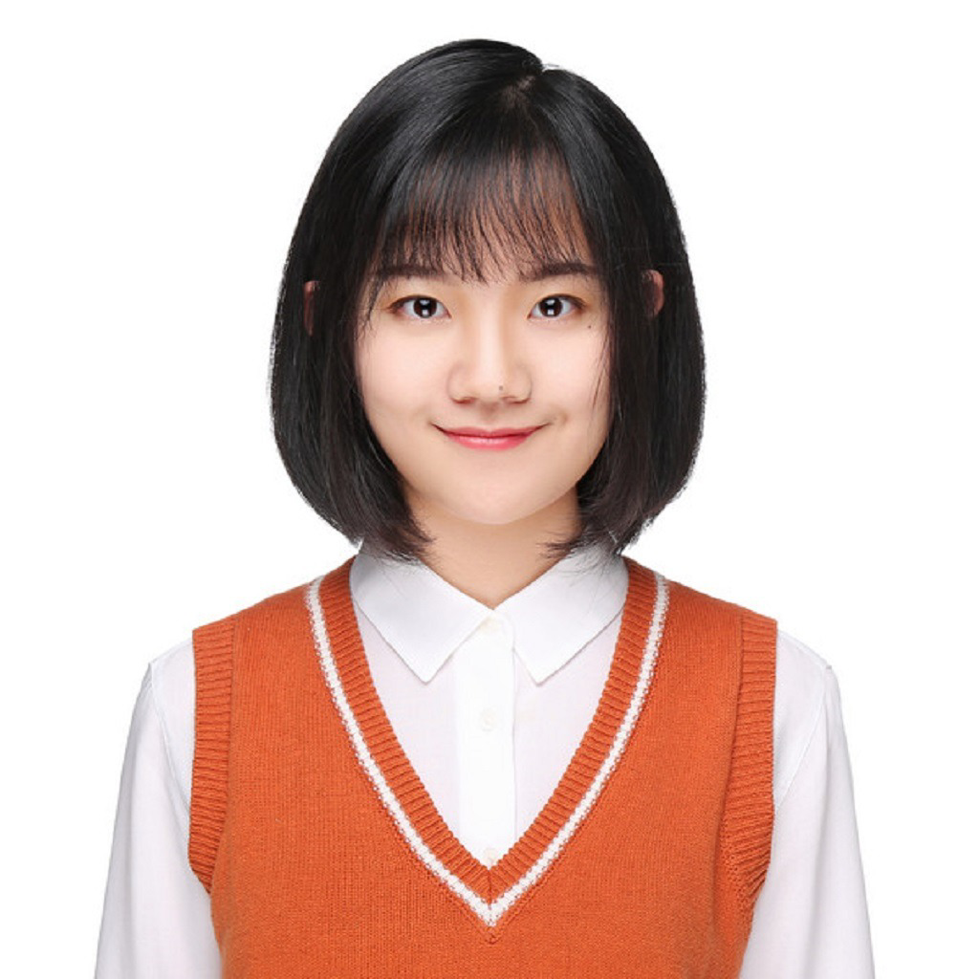

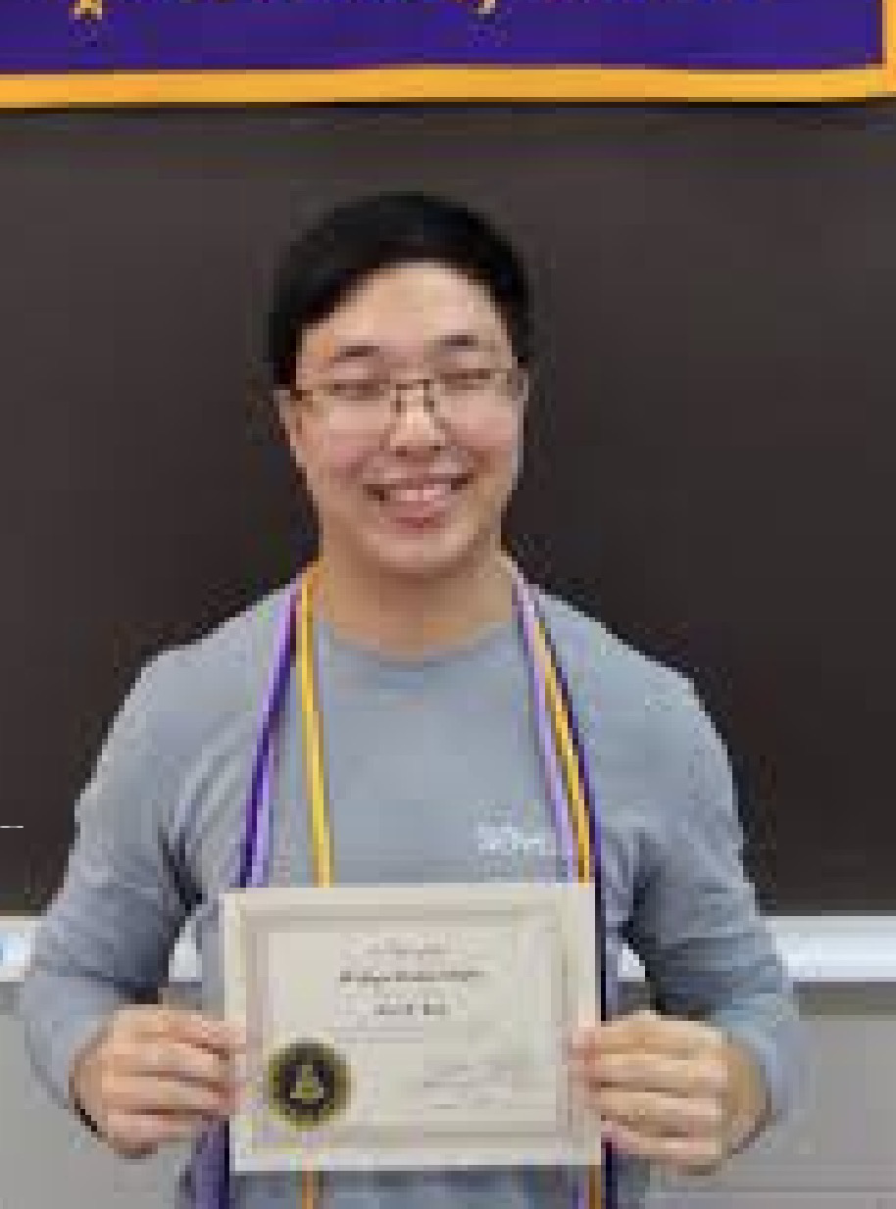
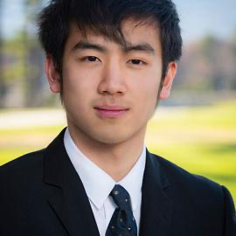
Meng Jiang
蒋朦
Associate Professor
(effective July 1, 2023)
Wenhao Yu 于文豪
Bloomberg Fellowship
ICLR’23, EMNLP’22 * 2, ACL’22 * 2,
EMNLP’21 * 2, NAACL’21, WWW’20 * 2
LLM and open-domain QA
Qingkai Zeng
曾庆锴
KDD’21, EMNLP’20
Information Extraction
Taxonomy Construction
Faculty
PhD Cand.
Zhihan Zhang
张智涵
TACL’23, EMNLP’22
LLM and open-domain QA
Instruction Tuning
Noah Ziems
诺亚
ACL’23
LLM and open-domain QA
Controlled Text Generation
Mengxia Yu
虞梦夏
CSE Select Fellowship
LLM for Education
Comparative Reasoning
PhD Student
Lingbo Tong
仝凌波
Psychology-CSE Joint PhD
LLM for Mental Health
Knowledge Graph
Hy Dang
LLM for Mental Health
Query Expansion
Bang Nguyen
LLM for Education
Query/Question Generation
Zhaoxuan Tan
谭兆轩
LLM for User Profiling
Mengzhao Jia
贾梦朝
LLM for User Profiling
Eric Inae
Dean’s Fellowship
Zheyuan Liu
刘哲源
Gang Liu
刘罡
KDD’22, KDD’23 GNN for Material Science
Knowledge-intensive NLP tasks

Slide 3
What are knowledge-intensive NLP tasks?
They are tasks that humans could not reasonably be expected to perform without access to an external knowledge source [1].
[1] Lewis et al. Retrieval-Augmented Generation for Knowledge-Intensive NLP Tasks. NeurIPS 2020. https://arxiv.org/pdf/2005.11401.pdf
Can you give some examples?
Sure. The unified benchmark of Knowledge Intensive Language Tasks (KILT) includes open-domain question answering, fact checking, slot filling, entity linking, dialogue, etc. [2].
[2] Petroni et al. KILT: a Benchmark for Knowledge Intensive Language Tasks. NAACL 2021. https://arxiv.org/pdf/2009.02252.pdf
What may not be knowledge-intensive NLP tasks?
Machine translation, machine reading comprehension, summarization, sentiment analysis.
They are tasks that humans could not reasonably be expected to perform without access to an external knowledge source [1].
[1] Lewis et al. Retrieval-Augmented Generation for Knowledge-Intensive NLP Tasks. NeurIPS 2020. https://arxiv.org/pdf/2005.11401.pdf

Slide 4
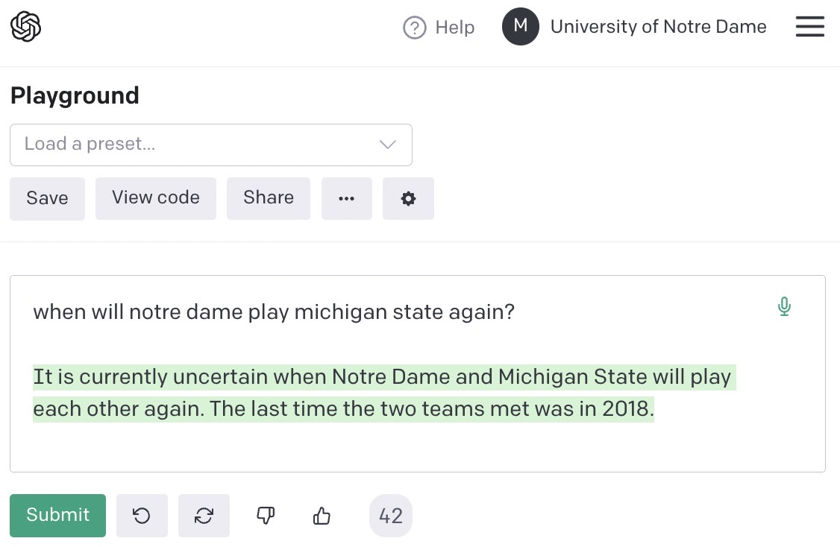
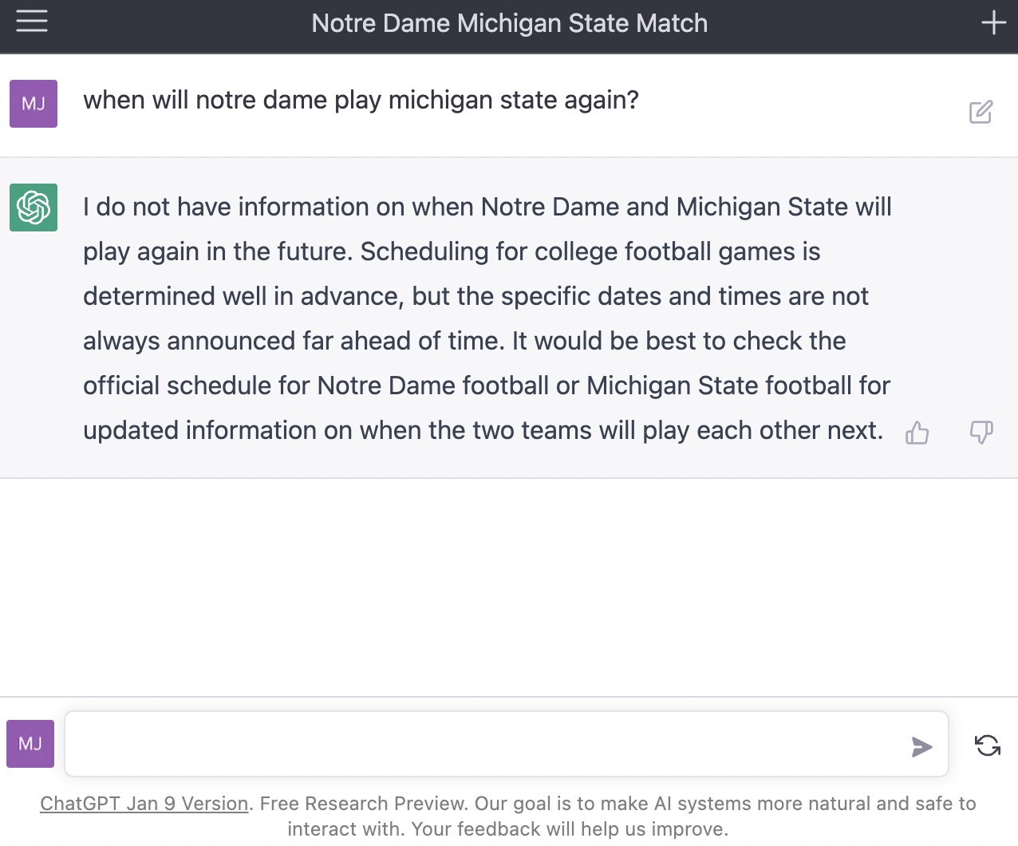
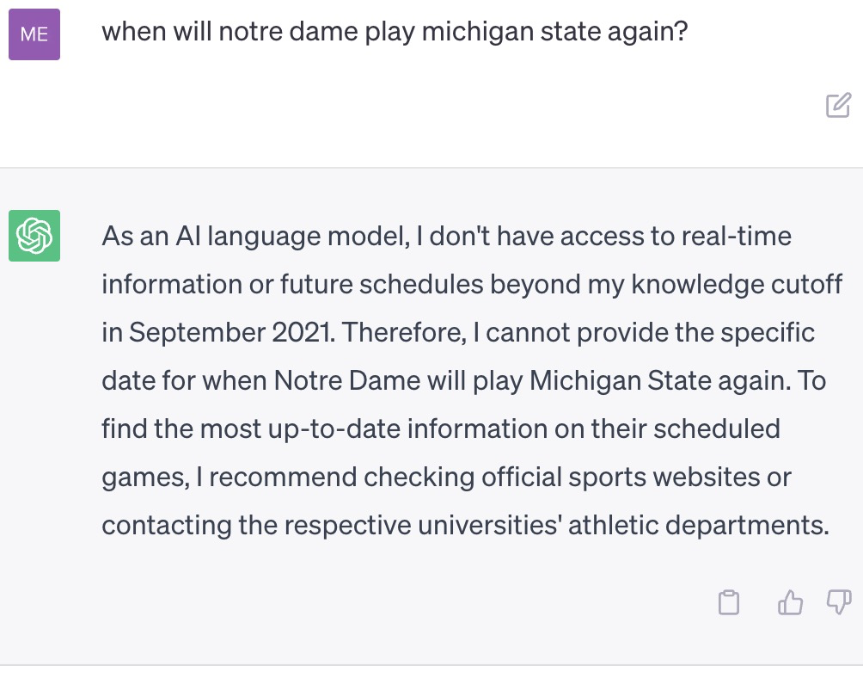
Can you give a question example about open-domain question answering? I’d love to see one about Notre Dame if it exists in the benchmark.
Sure. In the Natural Questions (NQ) benchmark [3], there is a question: “when will notre dame play michigan state again?”
[3] Kwiatkowski et al. Natural Questions: A Benchmark for Question Answering Research. TACL 2019. https://ai.google.com/research/NaturalQuestions
Thanks. Can GPT-3, ChatGPT, or ChatGPT-Plus and answer this question?
No answer!
No answer & Wrong fact
No answer!

Slide 5
Closed-Book
Large Language Model (LLM)
Pre-collected corpus
Pre-training
175 Billion parameters
(or bigger)
(self-supervision)
Human feedback
R. L.
Input (e.g. question)
Output
tasks
Lack of (up-to-date) knowledge
Lack of fine-tuning flexibility
Lack of evidence traceability / reliability

Slide 6
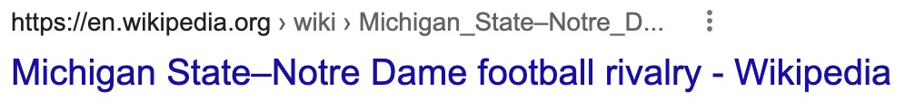
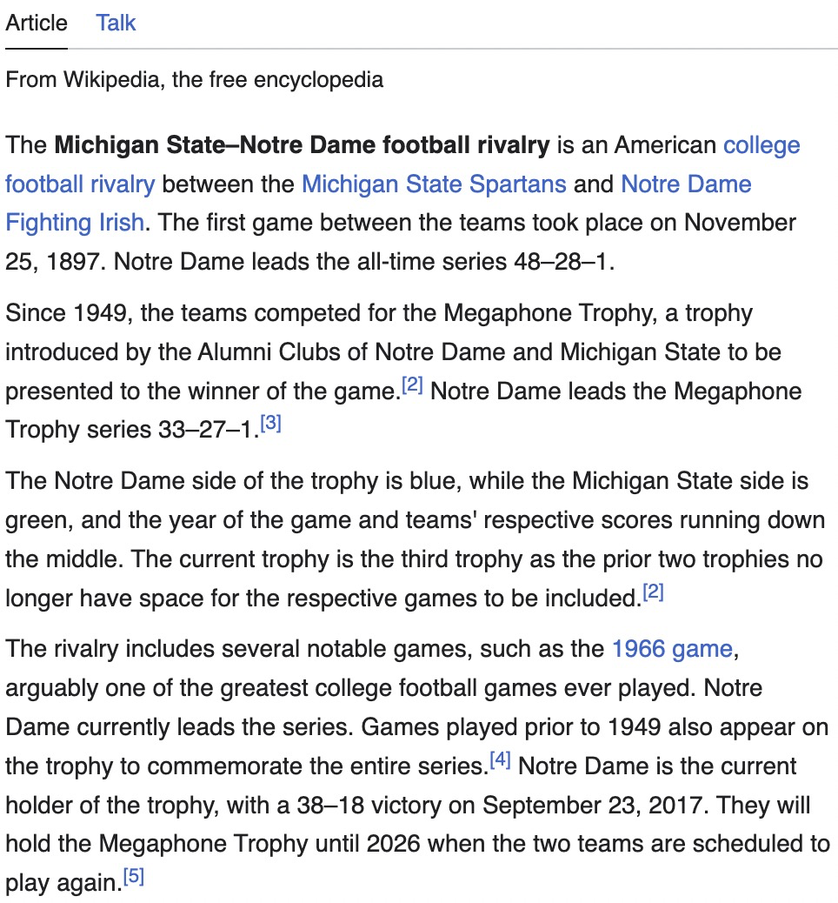
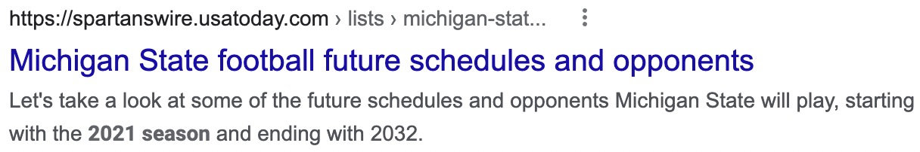
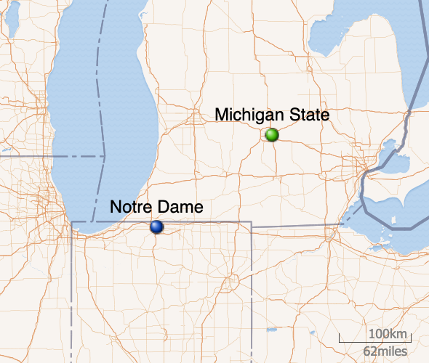


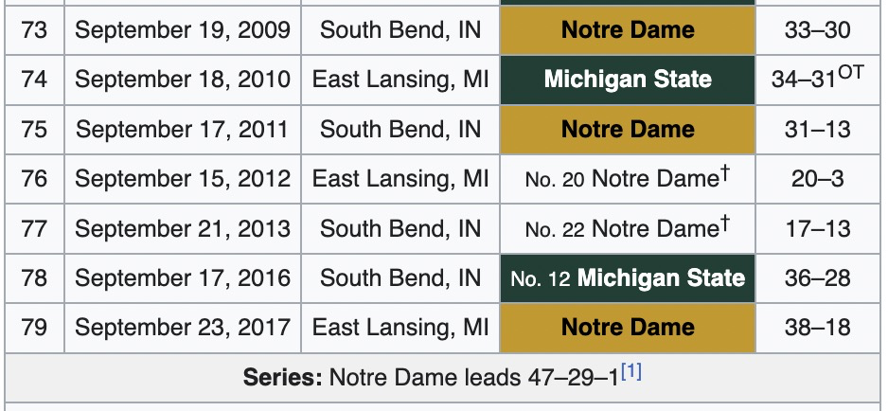
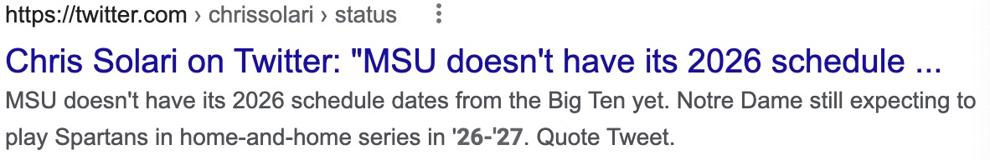
How do humans find the answer?
read
Wikipedia
search

Slide 7
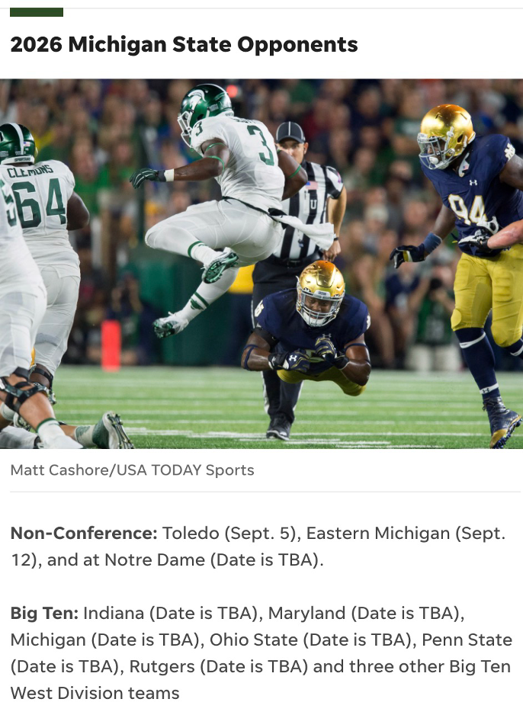
How do humans find the answer?
Wikipedia
News (August 20, 2021)
read
search

Slide 8
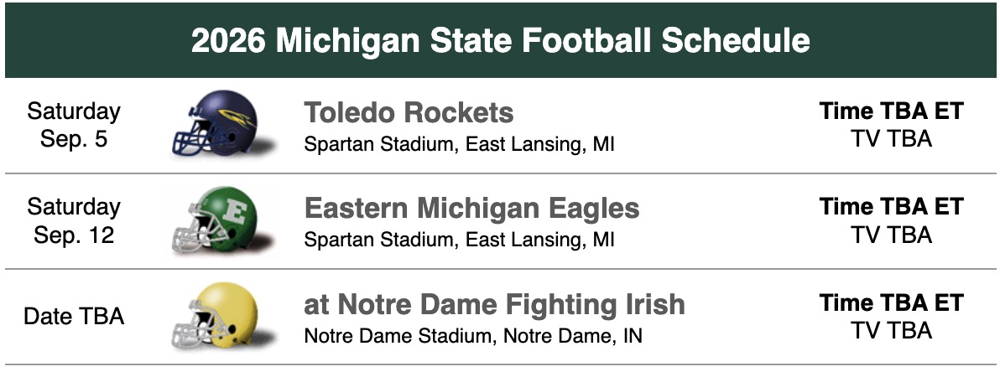
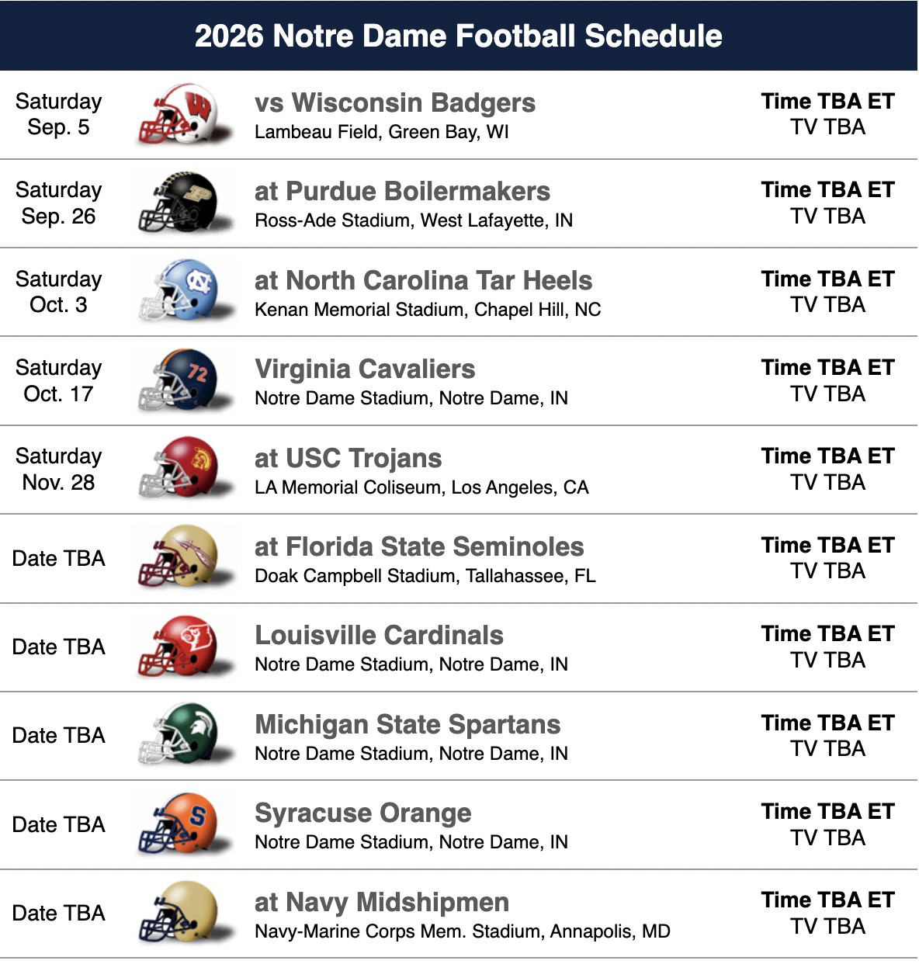
How do humans find the answer?
Wikipedia
News (August 20, 2021)
search
Database
read

Slide 9
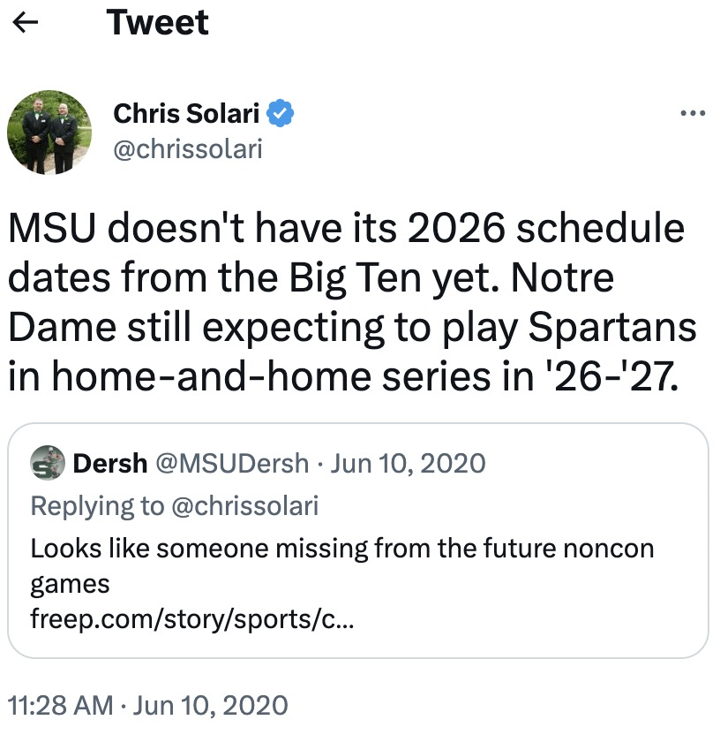
How do humans find the answer?
Wikipedia
News (August 20, 2021)
search
Database
Social media (June 10, 2020)

Slide 10
Closed-Book
Open-Book
Large Language Model (LLM)
Knowledge Augmentation
Pre-collected corpus
Pre-training
175 Billion parameters
(or bigger)
External
(up-to-date)
knowledge
sources
Wikipedia
News
Database
Social media
…
(self-supervision)
Human feedback
R. L.
Retriever
(~0.12B)
Input (e.g. question)
Output
Input
Knowledge
(e.g., passage)
Output
tasks
tasks
Lack of (up-to-date) knowledge
Lack of fine-tuning flexibility
Lack of evidence traceability / reliability
Reader/Generator
(< 0.25B parameters)

Slide 11
Knowledge-Augmented NLP
Knowledge Source Heterogeneity: How to retrieve useful knowledge from multiple types of sources for effective augmentation?
Adapted Knowledge: External data are independent from the input. The retrieved knowledge may not fully understand the input. Is there a better knowledge source than Data?
Efficiency: Indexing and retrieval spend ~150× time than closed-book models. Can we do knowledge augmentation faster?
External
(up-to-date)
knowledge
sources
Wikipedia
News
Database
Social media
…
Retriever
(~0.12B)
Input
Knowledge
Output
Reader/Generator
(< 0.25B parameters)

Slide 12
Knowledge-Augmented NLP
Knowledge Source Heterogeneity: How to retrieve useful knowledge from multiple types of sources for effective augmentation?
Adapted Knowledge: External data are independent from the input. The retrieved knowledge may not fully understand the input. Is there a better knowledge source than Data?
Efficiency: Indexing and retrieval spend ~150× time than closed-book models. Can we do knowledge augmentation faster?
External
(up-to-date)
knowledge
sources
Wikipedia
News
Database
Social media
…
Retriever
(~0.12B)
Input
Knowledge
Output
Reader/Generator
(< 0.25B parameters)

Slide 13




Retrieval Augmentation for Commonsense Reasoning: A Unified Approach
Abu Dhabi
The 2022 Conference on Empirical Methods in Natural Language Processing
Wenhao Yu, Chenguang Zhu, Zhihan Zhang, Shuohang Wang, Zhuosheng Zhang, Yuwei Fang, Meng Jiang

Slide 14
Multi-choice Commonsense Question Answering
Commonsense Fact Verification
Where can I stand on a river to see water falling without getting wet?
A pound of cotton has the same weight as a pound of steel.
A) waterfall
B) bridge
C) valley
D) stream
E) bottom
True
False
Datasets:
OpenBookQA: Clark et al. arxiv 2018. (5,957 questions)
CommonsenseQA 1.0： Talmor et al. NAACL 2019. (12,102)
Evaluation: Accuracy.
Datasets:
CommonsenseQA 2.0: Talmor et al. (14,343 assertions)
CREAK： Onoe et al. NeurIPS 2021 Benchmark Track. (13,000)
Evaluation: Accuracy.
Constrained Commonsense Generation
Counterfactual Explanation Generation
Constraints: dog, frisbee, catch, throw
I am hungry for water.
Description: A girl throws a frisbee and her dog catches it.
Outputs:
1) Water is used to quench thirsty.
2) You are thirsty for water, not hungry.
3) Water is not food.
Datasets:
CommonGen: Lin et al. Findings of EMNLP 2020. (79,000+ commonsense descriptions)
Evaluation: SPICE, BLEU-4, ROUGE-L, CIDEr.
Datasets:
ComVE: Wang et al. SemEval-2020 Task 4 (11,997 examples)
Evaluation: SPICE, BLEU-4, ROUGE-L, CIDEr.

Slide 15
Multi-choice Commonsense Question Answering
Commonsense Fact Verification
Zhang et al. GreaseLM: Graph Reasoning Enhanced Language Models. ICLR 2022.
Lourie et al. Unicorn on Rainbow: A Universal Commonsense Reasoning Model on a New Multitask Benchmark. AAAI 2021.
Where can I stand on a river to see water falling without getting wet?
A pound of cotton has the same weight as a pound of steel.
🏆
GreaseLM
QA-GNN
KAGNet
UNICORN
T5-Large
…
🏆
UNICORN
GreaseLM
T5-Large
QA-GNN
KGNet
…
A) waterfall
B) bridge
C) valley
D) stream
E) bottom
True
False
Datasets:
OpenBookQA: Clark et al. arxiv 2018. (5,957 questions)
CommonsenseQA 1.0： Talmor et al. NAACL 2019. (12,102)
Evaluation: Accuracy.
Datasets:
CommonsenseQA 2.0: Talmor et al. (14,343 assertions)
CREAK： Onoe et al. NeurIPS 2021 Benchmark Track. (13,000)
Evaluation: Accuracy.
Constrained Commonsense Generation
Counterfactual Explanation Generation
Li et al. KFCNet: Knowledge Filtering and Contrastive Learning for Generative Commonsense Reasoning. Findings of EMNLP 2021.
Constraints: dog, frisbee, catch, throw
I am hungry for water.
🏆
KFCNet
UNICORN
KG-BART
CALM
T5-Large
…
🏆
UNICORN
CALM
MoKGE
T5-Large
GraphRF
…
Description: A girl throws a frisbee and her dog catches it.
Outputs:
1) Water is used to quench thirsty.
2) You are thirsty for water, not hungry.
3) Water is not food.
Datasets:
CommonGen: Lin et al. Findings of EMNLP 2020. (79,000+ commonsense descriptions)
Evaluation: SPICE, BLEU-4, ROUGE-L, CIDEr.
Datasets:
ComVE: Wang et al. SemEval-2020 Task 4 (11,997 examples)
Evaluation: SPICE, BLEU-4, ROUGE-L, CIDEr.

Slide 16
Multi-choice Commonsense Question Answering
Commonsense Fact Verification
Commonsense Benchmark Datasets
GreaseLM
Trained with
Human Annotated Facts
(e.g., Relations, Knowledge Graphs)
OMCS (Havasi et al. 2010)
ATOMIC (Sap et al. 2019)
Wiktionary (Meyer et al. 2012)
UNICORN ON RAINBOW
Trained with
Commonsense Benchmark Datasets
αNLI (Bhagavatula et al. 2020): Narrative abductive reasoning
COSMOSQA (Huang et al. 2019): Commonsense reading comprehension
HELLASWAG (Zellers et al. 2019)
PIQA (Bisk et al. 2020) : Physical commonsense reasoning
SOCIALIQA (Sap et al. 2019): Commonsense reasoning about social situations and interactions
…
Zhang et al. GreaseLM: Graph Reasoning Enhanced Language Models. ICLR 2022.
Lourie et al. Unicorn on Rainbow: A Universal Commonsense Reasoning Model on a New Multitask Benchmark. AAAI 2021.
Where can I stand on a river to see water falling without getting wet?
A pound of cotton has the same weight as a pound of steel.
αNLI
GreaseLM
QA-GNN
KAGNet
UNICORN
T5-Large
…
🏆
UNICORN
GreaseLM
T5-Large
QA-GNN
KGNet
…
🏆
HELLA
SWAG
COSMOSQA
A) waterfall
B) bridge
C) valley
D) stream
E) bottom
True
False
PIQA
SOCIAL
IQA
…
Datasets:
OpenBookQA: Clark et al. arxiv 2018. (5,957 questions)
CommonsenseQA 1.0： Talmor et al. NAACL 2019. (12,102)
Evaluation: Accuracy.
Datasets:
CommonsenseQA 2.0: Talmor et al. (14,343 assertions)
CREAK： Onoe et al. NeurIPS 2021 Benchmark Track. (13,000)
Evaluation: Accuracy.
Human Annotated Facts
(e.g., Relations, Knowledge Graphs)
Constrained Commonsense Generation
Counterfactual Explanation Generation
OMCS
ATOMIC
Wiktionary
KFCNet
Trained with
Commonsense Relevant Corpus
(e.g., Statements, Knowledge Bases)
ARC (Clark et al. 2018)
QASC (Khot et al. 2020)
GenericsKB (Bhakthavatsalam et al. 2020)
Li et al. KFCNet: Knowledge Filtering and Contrastive Learning for Generative Commonsense Reasoning. Findings of EMNLP 2021.
Constraints: dog, frisbee, catch, throw
I am hungry for water.
🏆
KFCNet
UNICORN
KG-BART
CALM
T5-Large
…
🏆
UNICORN
CALM
MoKGE
T5-Large
GraphRF
…
Description: A girl throws a frisbee and her dog catches it.
Outputs:
1) Water is used to quench thirsty.
2) You are thirsty for water, not hungry.
3) Water is not food.
…
Commonsense Relevant Corpus
(e.g., Statements, Knowledge Bases)
ARC
QASC
GenericsKB
…
Datasets:
CommonGen: Lin et al. Findings of EMNLP 2020. (79,000+ commonsense descriptions)
Evaluation: SPICE, BLEU-4, ROUGE-L, CIDEr.
Datasets:
ComVE: Wang et al. SemEval-2020 Task 4 (11,997 examples)
Evaluation: SPICE, BLEU-4, ROUGE-L, CIDEr.

Slide 17
Commonsense Benchmark Datasets
Where can I stand on a river to see water falling without getting wet?
αNLI
COSMOSQA
HELLA
SWAG
A) waterfall
B) bridge
C) valley
D) stream
E) bottom
PIQA
SOCIAL
IQA
…
A pound of cotton has the same weight as a pound of steel.
Human Annotated Facts
(e.g., Relations, Knowledge Graphs)
True
False
Constraints: dog, frisbee, catch, throw
OMCS
ATOMIC
Wiktionary
Description: A girl throws a frisbee and her dog catches it.
…
I am hungry for water.
Commonsense Relevant Corpus
(e.g., Statements, Knowledge Bases)
Outputs:
1) Water is used to quench thirsty.
2) You are thirsty for water, not hungry.
3) Water is not food.
ARC
QASC
GenericsKB
…

Slide 18
Unified Approach
Retrieval Augmentation for Commonsense Reasoning (RACo)
Dense Passage Retriever
Large-Scale
Commonsense
Corpus
Commonsense Benchmark Datasets
Source Heterogeneity
(e.g., transform KG / KB)
Human Annotated Facts
(e.g., Relations, Knowledge Graphs)
Commonsense Relevant Corpus
(e.g., Statements, Knowledge Bases)
Input
Retrieved Passages
Output
Generator
(as classifier if needed)
Multi-choice Commonsense Question Answering
Commonsense Fact Verification
Training Retriever without golden passages
Constrained Commonsense Generation
Counterfactual Explanation Generation

Slide 19
Multi-choice Commonsense Question Answering
Commonsense Fact Verification
(Accuracy) | CSQA1.0 | OBQA
RACo | 75.76 | 71.25
GreaseLM | 74.20 | 66.90
QA-GNN | 73.40 | 67.80
UNICORN | 71.60 | 70.02
T5-Large | 70.14 | 66.02
KAGNet | 69.00 | -
(Accuracy) | CSQA2.0 | CREAK
RACo | 61.75 | 84.17
UNICORN | 54.90 | 79.51
GreaseLM | - | 77.51
T5-Large | 54.60 | 77.32
🏆
🏆
Constrained Commonsense Generation
Counterfactual Explanation Generation
CommonGen | (BL-4) | (SPICE)
RACo | 42.76 | 33.89
KFCNet | 41.97 | 33.11
UNICORN | 39.86 | 33.20
KG-BART | 30.90 | 32.70
CALM | 29.50 | 30.20
T5-Large | 28.60 | 31.60
ComVE | (BL-4) | (SPICE)
RACo | 25.30 | 36.37
UNICORN | 24.46 | 35.79
CALM | 23.50 | 35.23
MoKGE | 22.87 | 34.88
T5-Large | 22.77 | 34.62
GraphRF | 22.07 | 33.09
🏆
🏆

Slide 20
Insights on Knowledge-Augmented NLP
Knowledge Source Heterogeneity
Unified approach is effective for various commonsense reasoning NLP tasks.
Transforming knowledge graphs, knowledge bases, etc. into text passages is effective for retrieval augmentation.
Will this methodology be effective for open-domain question answering?
when will notre dame play michigan state again?
Wikipedia
√
√
√
√
USAToday
√
√
√
FBS Schedules
√
√
√
Twitter
Output
N/A
2026
2026
2026
2026
2026

Slide 21
Knowledge-Augmented NLP
Knowledge Source Heterogeneity: How to retrieve useful knowledge from multiple types of sources for effective augmentation?
Adapted Knowledge: External data are independent from the input. The retrieved knowledge may not fully understand the input. Is there a better knowledge source than Data?
Efficiency: Indexing and retrieval spend ~150× time than closed-book models. Can we do knowledge augmentation faster?
External
(up-to-date)
knowledge
sources
Wikipedia
News
Database
Social media
…
Retriever
(~0.12B)
Input
Knowledge
Output
Reader/Generator
(< 0.25B parameters)

Slide 22
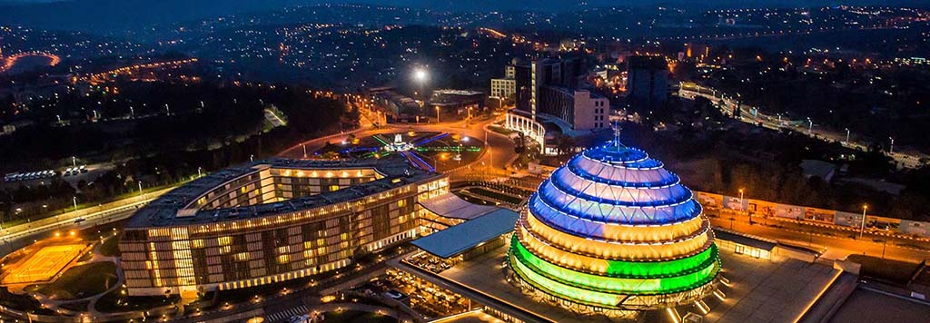
Generate rather than Retrieve: Large Language Models are Strong Context Generators
Kigali Rwanda
The 2023 International Conference on Learning Representations
Wenhao Yu, Dan Iter, Shuohang Wang, Yichong Xu, Mingxuan Ju, Soumya Sanyal, Chenguang Zhu, Michael Zeng, Meng Jiang

Slide 23
Open-Domain Question Answering
LLMs in Open-Book Framework
Wikipedia
GPT-3
Retriever
Retrieved passages
Generated passages
Question
Answer
Question
Answer
Reader
Reader

Slide 24

Why not use GPT-3 to directly generate the answer?
Who got the first Nobel prize in physics?
Who got the first Nobel prize in physics?
“Generate a background document to answer
the given question [Q]:”
“Question: [Q] Answer:”
Zero-Shot Open-Domain Question Answering
The first Nobel Prize in Physics was awarded in 1901 to Wilhelm Conrad Rontgen in recognition of the extraordinary services he has rendered by the discovery of the remarkable rays subsequently named after him
GPT-3
(175 Billion parameters)
GPT-3
(Exact Match) | Web Questions | Natural Questions | TriviaQA
Ours | 24.8 | 28.2 | 59.3
PaLM (540B) | 19.0 | 24.7 | 56.7
InstructGPT | 18.6 | 20.9 | 52.6
🏆
“Question: [Q]
Passage: [P]
Answer: ”
GPT-3
Albert Einstein.
Wilhelm Conrad Rontgen
GPT-3 is not a reader specialist. Fusion-in-Decoder (FiD) is the state-of-the-art Reader. Supervised Learning (with FiD) performs much better than Zero-Shot.
Izacard and Grave. Leveraging Passage Retrieval with Generative Models for Open Domain Question Answering. EACL 2021.

Slide 25

GenRead: Supervised Learning
“Many shots”: Training QA specialists
WebQ | NaturalQ | TriviaQA
56.2 | 54.0 | 74.3
55.4 | - | 72.6
54.5 | 45.6 | 71.6
50.8 | 50.1 | 66.3
53.6 | 45.0 | 65.4
46.5 | 42.8 | 65.4
24.8 28.2 | 28.2 37.5 | 59.3 86.1
Merged | Reader
GPT-3 + DPR | FiD
🏆
Passages complementarity
Ours:
Generator | Reader
Codex | FiD
GPT-3 | FiD
Ours:
LLMs are effective for
knowledge augmentation
Ours:
Retriever | Reader
DPR | FiD
Google API | FiD
BM25 | FiD
State-of-the-art:
Open-book $≫$ Closed-book
Supervision $≫$ Zero-shot
Generator (closed-book)
GPT-3 (zero-shot) PALM 2-L (one-shot)
(released 5/10/2023)

Slide 26
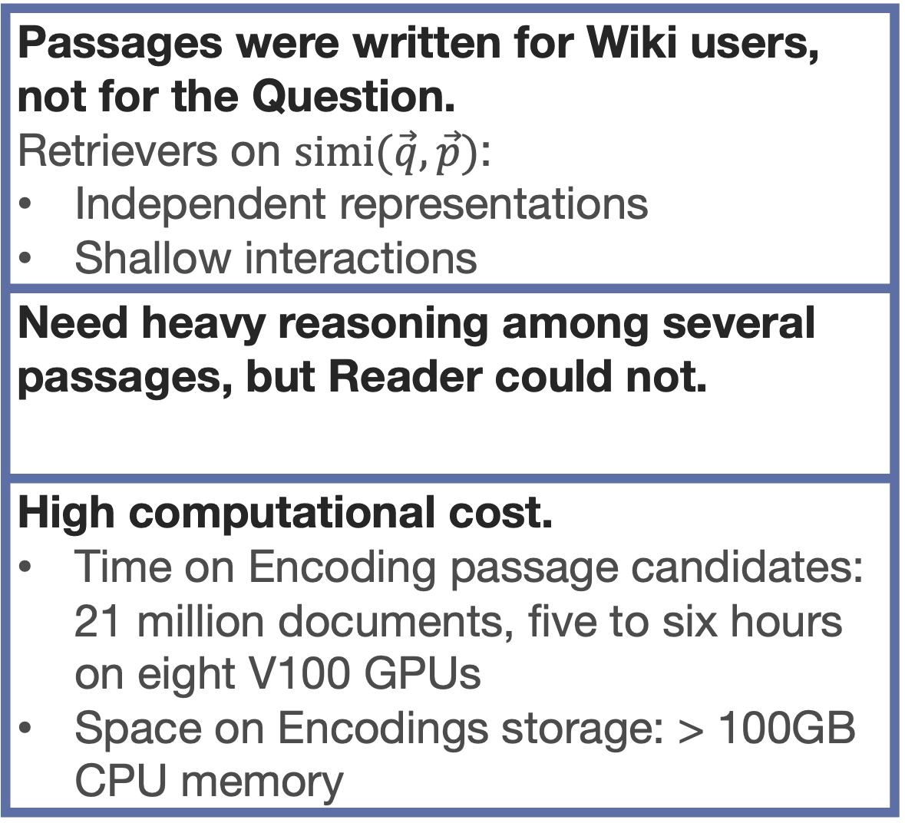
Retrieved Passages vs Generated Passages
Passages were written for Wiki users, not for the Question. Retrievers on $simi(\vec{q},\vec{p})$: Independent representations Shallow interactions
Need heavy reasoning among several passages, but Reader could not.
High computational cost. Time on Encoding passage candidates: 21 million documents, five to six hours on eight V100 GPUs Space on Encodings storage: > 100GB CPU memory
LLMs understand every word in Question to create Passages. GPT-3 and its family models: Highly expressive with Cross-attention
LLMs have shown reasoning abilities Learned from large pre-trained corpora Complex reasoning at a certain level
Efficiency Just “look up” world knowledge stored in the model parameters
IF DOMAIN MATCHED AND API AVAILABLE The information needed in target task (e.g., QA) was collected when pre-training LLMs.
!

Slide 27
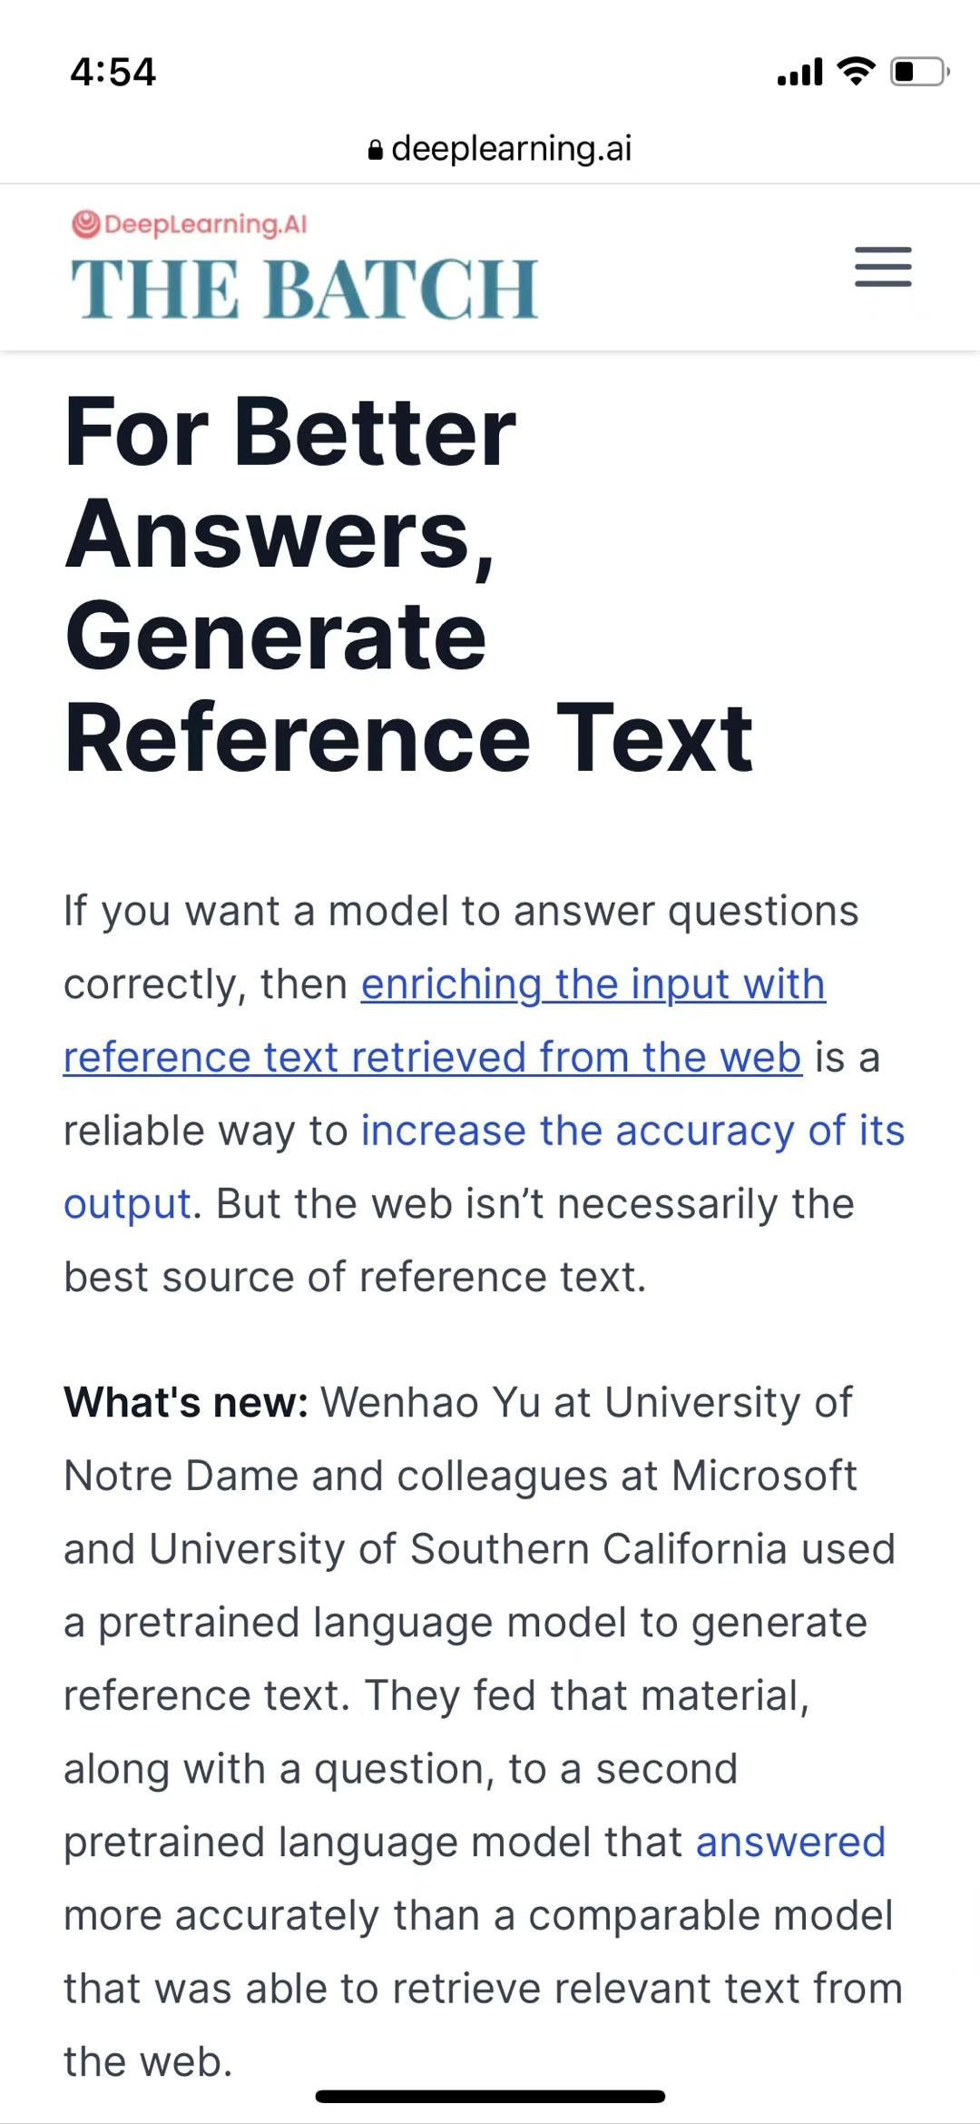
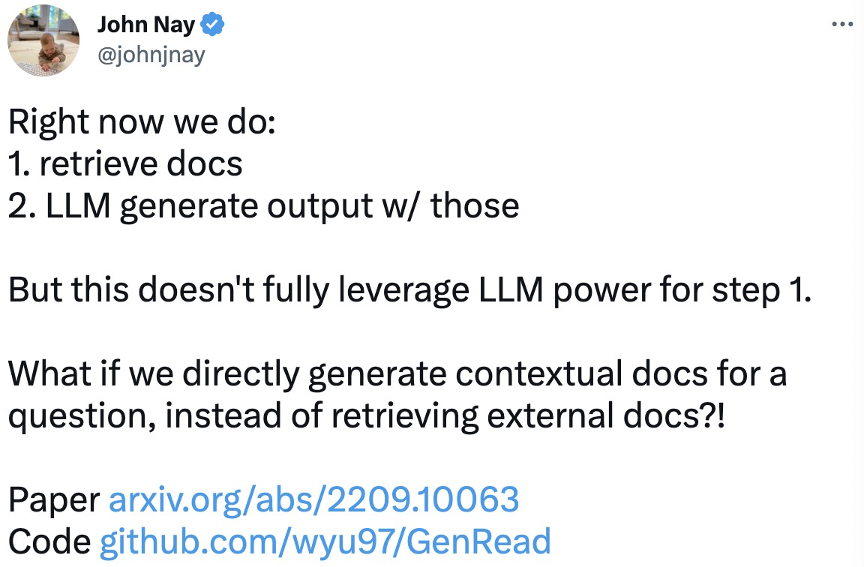
Insights on Knowledge-Augmented NLP
Adapted Knowledge Augmentation with LLMs
GPT-3
More you can find from the paper/code:
GenRead’s performance on fact checking, dialogue system, etc.
GenRead’s method on diversifying generated passages. Limitation: Hallucination!
GenRead’s analysis on LLM model size and performance.
Generated knowledge
Input
Output
Reader

Slide 28
Surprising Zero-Shot / Few-Shot Performance
Large Language Models are Auto-regressive Search Engines (ACL-Findings 2023)
GPT-3
GPT-3
Generated URLs
Wikipedia
Passages
90% contain answer
w/o indexing docs
Generated passages
Input
Output
Input
Output
“Question: [Q]. Which [k] URLs would have the answer?”
GPT-3
GPT-3
GenRead
LLM-URL
(Exact Match) | Web Questions | Natural Questions | TriviaQA
LLM-URL (few-shot) | 29.0 | 27.3 | 60.7
LLM-URL (zero-shot) | 28.1 | 26.4 | 60.1
GenRead (zero-shot) | 24.8 | 28.2 | 59.3
PaLM (540B) | 19.0 | 24.7 | 56.7
InstructGPT | 18.6 | 20.9 | 52.6

Slide 29
Knowledge-Augmented NLP
Knowledge Source Heterogeneity: How to retrieve useful knowledge from multiple types of sources for effective augmentation?
Adapted Knowledge: External data are independent from the input. The retrieved knowledge may not fully understand the input. Is there a better knowledge source than Data?
Efficiency: Indexing and retrieval spend ~150× time than closed-book models. Can we do knowledge augmentation faster?
External
(up-to-date)
knowledge
sources
Wikipedia
News
Database
Social media
…
Retriever
(~0.12B)
Input
Knowledge
Output
Reader/Generator
(< 0.25B parameters)

Slide 30
A Unified Encoder-Decoder Framework with Entity Memory
Abu Dhabi
The 2022 Conference on Empirical Methods in Natural Language Processing
Zhihan Zhang, Wenhao Yu, Chenguang Zhu, Meng Jiang

Slide 31
Efficiency, Accuracy, and Generalizability
Book
Memory
[Févry, et al.
EMNLP 2020.]
DPR
Text
Entity
Embeddings
Input
Output
Input
Output
Input
Output
BART/
Linker
FiD
Linker
Closed-Book
Open-Book
Closed Book with Entity Memory (EaE)
 | Inference Time (TriviaQA) |  |  | Answer Prediction (EM) |  |  | Text Generation (R-L)
 | Index | Retrieval | Prediction | TriviaQA | NQ | WebQ | CREAK | MSMARCO | ELI5
BART | 0 | 0 | 18s | 25.02 | 24.82 | 29.23 | 30.34 | 53.26 | 22.99
Linker |  |  |  | 27.54 | 25.96 | 29.38 | × | × | ×
EaE | 0 | 0 | 20s | 41.01 | 25.54 | 38.88 | × | × | ×
Open-Book | 29min | 15min | 41min | 67.60 | 51.40 | 47.64 | - | - | -
Closed-Book
EaE | 0 | 0 | 20s | 41.01 | 25.54 | 38.88 | × | × | ×

Slide 32

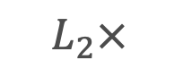

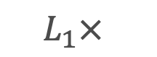
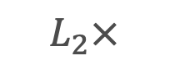

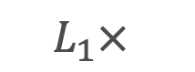

EDMem: Encoder-Decoder with Memory
Enabling Efficient Question Answering and Text Generation
[Es] Down House [Ee]
$$ℒ$$
Pre-training the memory on
Entity linking (as EaE)
Random token masking (for language modeling)
Salient span masking (for text generation)
Advantages:
In QA (vs EaE): create both entity and non-entity answers
In text generation (vs BART): generating more entities without sacrificing fluency
Language Modeling Head
$$ℒ$$
$$H$$
Entity Linking Head
Transformer Encoder
Transformer Decoder
$$L_{2}×$$
$$L_{2}×$$
$$H$$
+
$$L_{1}×$$
+
Transformer Encoder
Transformer Decoder
$$H$$
$$L_{1}×$$
Entity Memory
Where did [Es] Charles Darwin [Ee] live?
[BOS] [Es] Down House

Slide 33
Insights on Knowledge-Augmented NLP
Efficient Augmentation with Memory
 | Inference Time (TriviaQA) |  |  | Answer Prediction (EM) |  |  | Text Generation (R-L)
 | Index | Retrieval | Prediction | TriviaQA | NQ | WebQ | CREAK | MSMARCO | ELI5
BART | 0 | 0 | 18s | 25.02 | 24.82 | 29.23 | 30.34 | 53.26 | 22.99
Linker |  |  |  | 27.54 | 25.96 | 29.38 | × | × | ×
EaE | 0 | 0 | 20s | 41.01 | 25.54 | 38.88 | × | × | ×
EDMem | 0 | 0 | 20s | 47.23 | 30.19 | 41.44 | 31.78 | 54.45 | 23.97
Open-Book | 29min | 15min | 41min | 67.60 | 51.40 | 47.64 | - | - | -
Unified approach is effective for QA and text generation tasks.
Pre-trained memory can efficiently augment predictors/decoders.
Find in the paper: Investigating entity-aware decoding strategies.

Slide 34
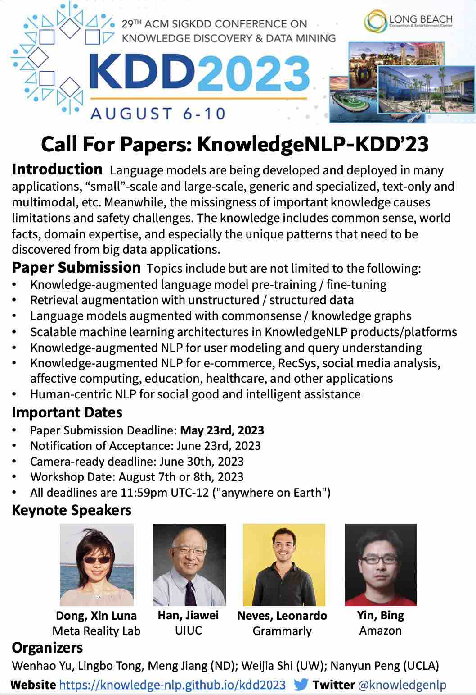
Knowledge-Augmented NLP
Find us, when you go to the next conference!
Survey paper:
A survey of knowledge-enhanced text generation. ACM Computing Surveys, 2022. (100+ citations)
GitHub: https://github.com/wyu97/KENLG-Reading (500+ stars)
Tutorials:
Knowledge-Enriched Natural Language Generation. EMNLP 2021. https://kenlg-tutorial.github.io/
Knowledge-Augmented Methods for Natural Language Processing. ACL 2022.
Knowledge-Augmented Methods for Natural Language Processing. WSDM 2023.
Workshop:
The first workshop on Knowledge Augmented Methods for NLP (KnowledgeNLP-AAAI), 2023. https://knowledge-nlp.github.io/aaai2023/
The second workshop on Knowledge Augmented Methods for NLP (KnowledgeNLP-KDD), 2023. https://knowledge-nlp.github.io/kdd2023/

Slide 35
Knowledge-Augmented LLMs
What research problem are important in this era?
1. What is the foundational theory behind Transformer and LLMs?
2. What efficient architecture is more effective than Transformer?
3. How to make LLMs more efficient?
4. What applications can LLMs revolutionize?
5. How to effectively adapt LLMs to downstream tasks?
6. How to improve the learning capabilities of LLMs?
7. How to control the text generation of LLMs?
8. How to evaluate the performance of LLMs?
9. How to improve the tech ethics of LLMs?
10. How to democratize LLMs?
Efficiency
Effectiveness
in various knowledge-intensive NLP tasks

Slide 36
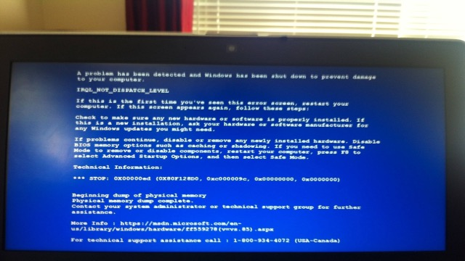





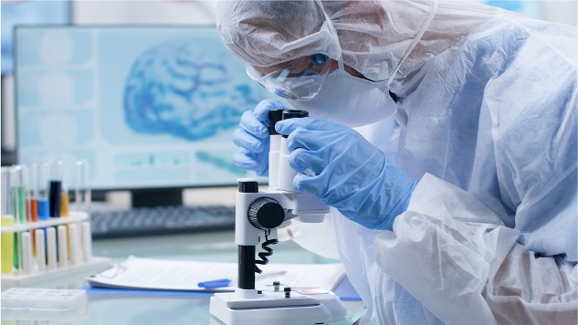

Technical Support
Online Education
Mental Health
Scientific Discovery
CAREER Award

Slide 37
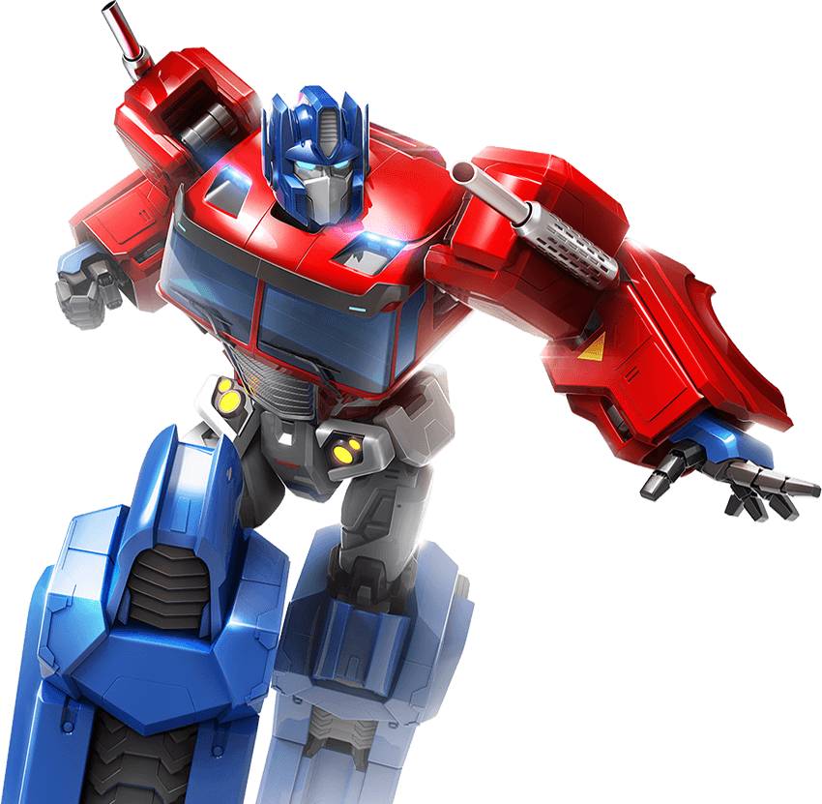
this talk
※ Commonsense
Human feedback
Domain knowledge
※ World facts
Personal data
Language patterns
Ethical principles
fluent | knowledgeable | reasonable | aligned | expert-like | personalized | trustworthy
Knowledge-intensive NLP tasks

Slide 38
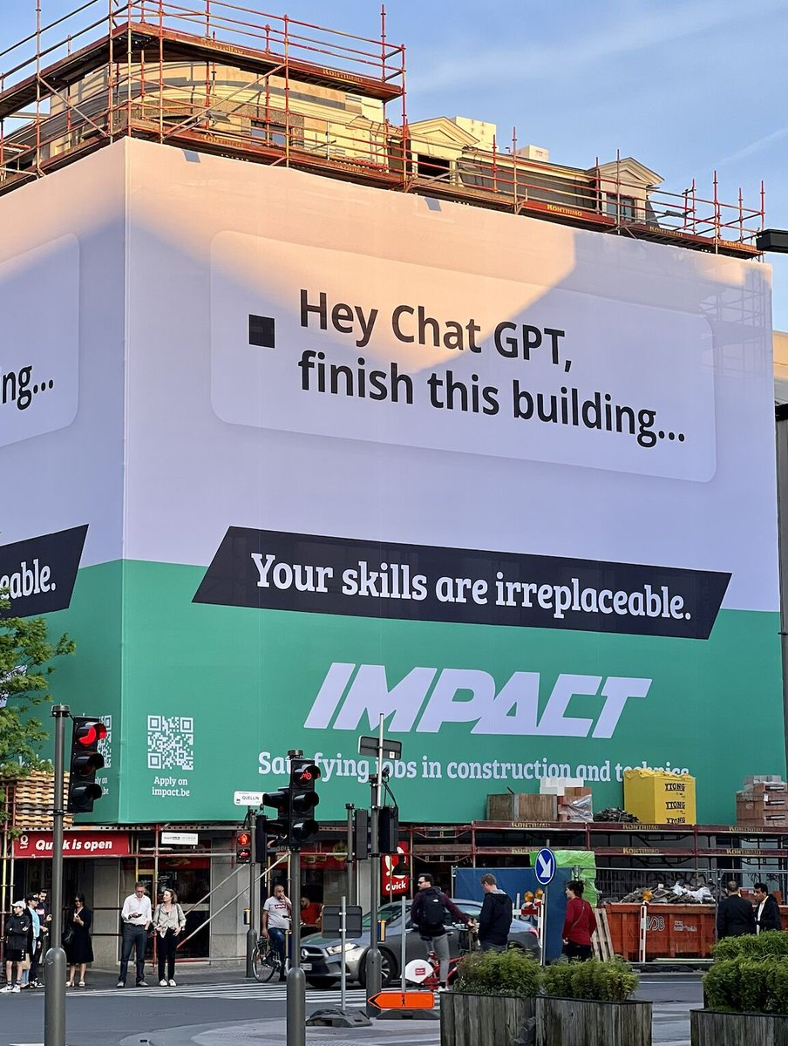

Slide 39

Welcome to visit our lab!
http://www.meng-jiang.com/lab.html
https://github.com/DM2-ND
mjiang2@nd.edu
39

Slide 40
Three Other Recent Work
Open-Domain Question Answering
HardQA: Exploring Contrast Consistency of Open-Domain Question Answering Systems on Minimally Edited Questions
in Transactions of the Association for Computational Linguistics (TACL), 2023.
IfQA: A Dataset for Open-Domain Question Answering under Counterfactual Presuppositions
https://arxiv.org/abs/2305.14010
ReFeed: Improving Language Models via Plug-and-Play Retrieval Feedback
https://arxiv.org/abs/2305.14002

